Slide 1
Cluster Analysis of Medicare Providers’ Fraud History
Nadya Soto
Centers for Medicare and Medicaid Services
Center for Program Integrity
August 2, 2018

Slide 2
Identifying ‘Risky’ Medicare Providers
How do we identify groups of providers who have a history of severe outcomes, and thus who pose the greatest “risk” to the Medicare Trust Fund?
We can create a dataset of providers who have investigations in our databases, and conduct a cluster analysis to identify groups of high-risk providers.
This information can then be used by investigative analysts to create models to better target these kinds of risky providers.

Slide 3
What is CoFraud?
CoFraud is short for “Combined Fraud”.
Includes data on:
Medicare and Medicaid investigations
Actions (e.g., revocations, payment suspensions)
Overpayments
Referrals to law enforcement
Compromised identifiers

Slide 4
Additional Data
In addition to the CoFraud data, the dataset for this data analysis will also include information such as:
Service area (e.g., hospital, home health agency, physician)
Provider specialty (if provider is Part B)
Provider’s state
Investigator jurisdiction

Slide 5
Data Exploration
62,000 observations, 13 variables
11 of 13 variables are categorical variables
Only one variable, Overpayments Amounts, is numerical
Distributions for both Part A (Institutional) and Part B (Physician) skew right

Slide 6
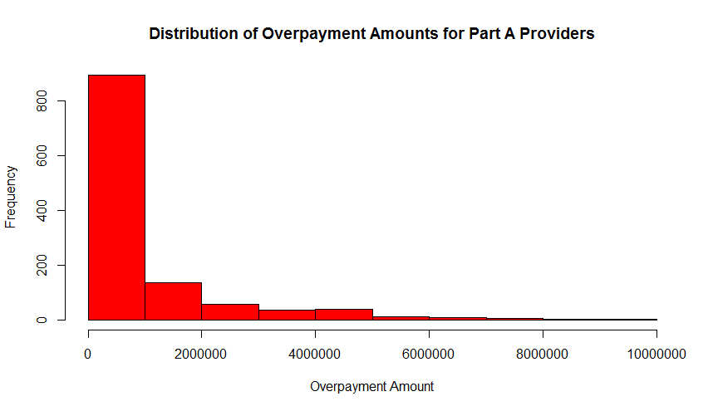
Distribution of Overpayments for Part A Providers

Slide 7
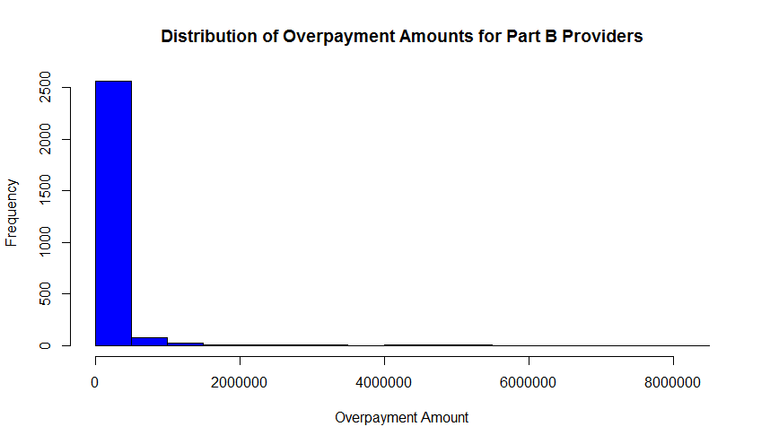
Distribution of Overpayments for Part B Providers

Slide 8
Capstone Analysis Strategy
Method: k-mode clustering analysis where k = 5
Similar to k-means, but best method for clustering categorical data
“The data given by data is clustered by the k-modes method (Huang, 1997) which aims to partition the objects into k groups such that the distance from objects to the assigned cluster modes is minimized.”
2 ways to impute NA values: impute with mode (most common category) or create third factor with NA values
Chose to create third factor of “NA” for data, as many of my categories were binary

Slide 9
Transformation of Data
Original dataset had over 30 columns, largely identifiers – dropped from dataset
Converted NPI to character instead of factor, as this is the data key/identifier
Removed invalid NPIs that do not have 10 digits, do not lead with 1, have dashes in them
Convert numerical categories to factors (e.g., Claim Type = 0, 1, 2, 3, or 4)

Slide 10
Transformation of Data (cont.)
Action records were either blank or populated with record name
Used ifthen statement to create indicator variables for action records (“Yes”/“No”)
Imputed NA variables for categorical data with a separate “None” factor

Slide 11
R methodology
Used klaR package in , which has a kmodes function to run k-modes analysis
Output:
cluster – A vector of integers indicating the cluster to which each object is allocated.
size – The number of objects in each cluster.
modes – A matrix of cluster modes.
withindiff – The within-cluster simple-matching distance for each cluster.
iterations – The number of iterations the algorithm has run.
weighted – Whether weighted distances were used or not.

Slide 12
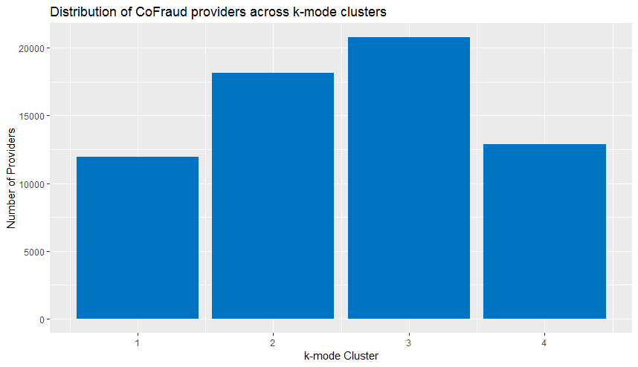
k-modes Clusters

Slide 13
New Questions
How to visualize clusters with categorical data?
So far, all clustering visualizations require numerical data
Difficult to find information on creating elbow and silhouette graphs with categorical clusters

Slide 14
Plan of Action
Create dataset
Clean and format data for analysis
Perform cluster analysis
Visualize results
Test clusters with existing categories
Share results with internally with team
Disseminate results to other stakeholders

